Slide 1

2024
Introduction to Microcontrollers
Giving circuits intelligence

Slide 2


Sign Up Now!
Notes:
QR to membership

Slide 3
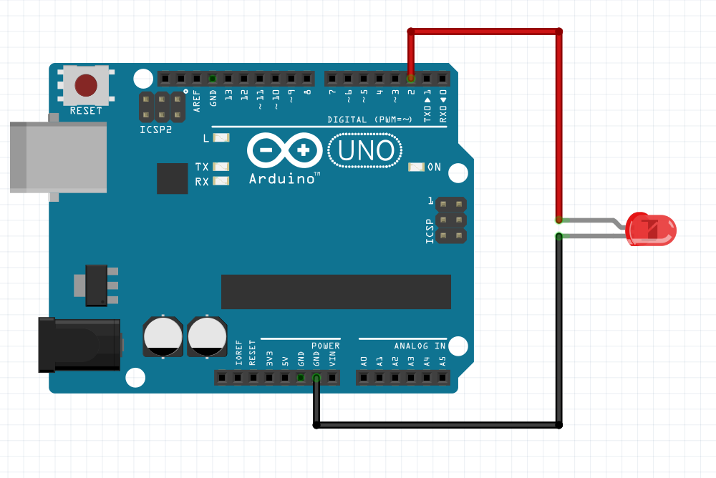
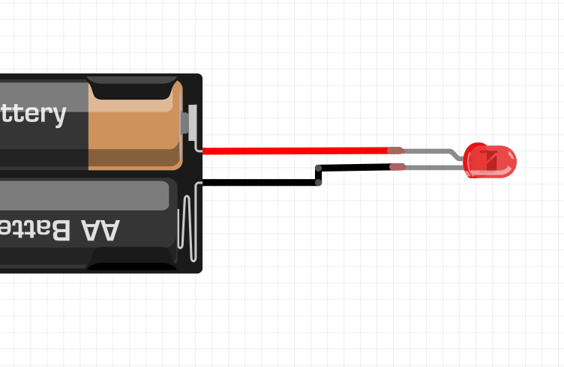
Intelligence

Slide 4
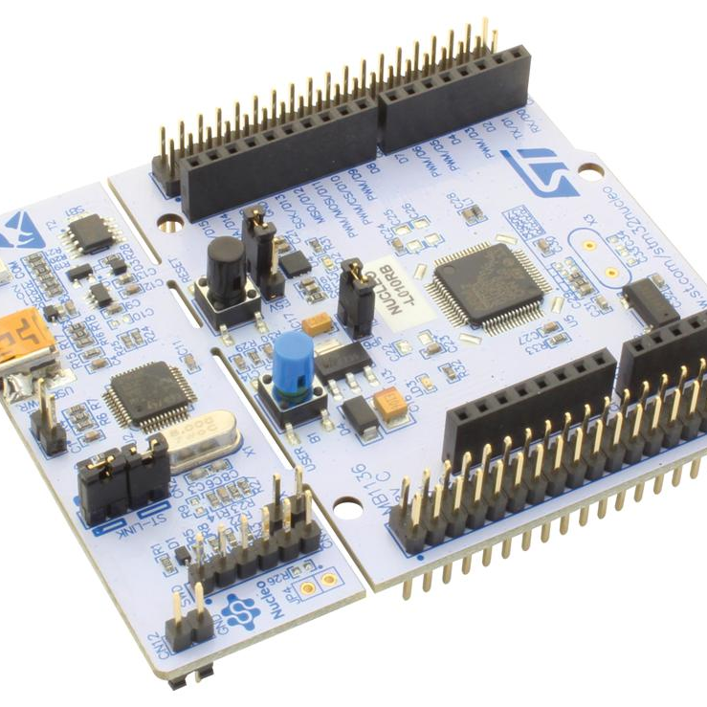
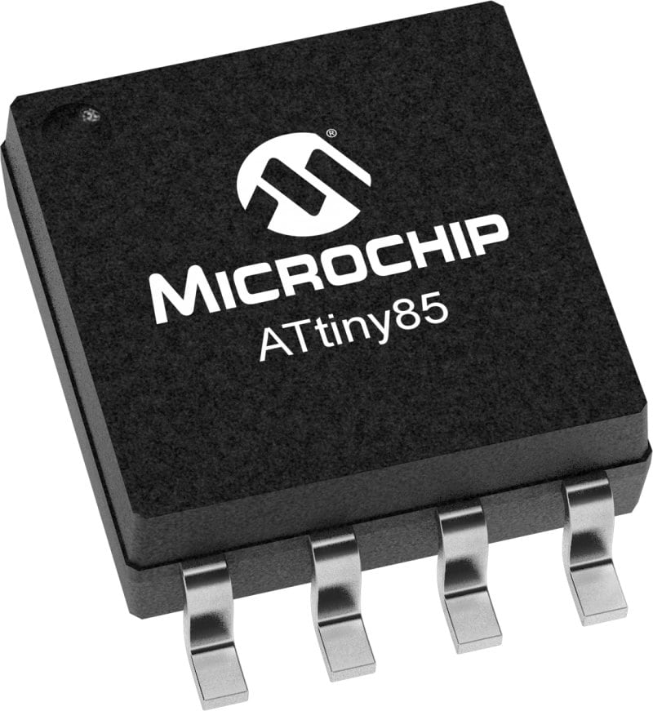
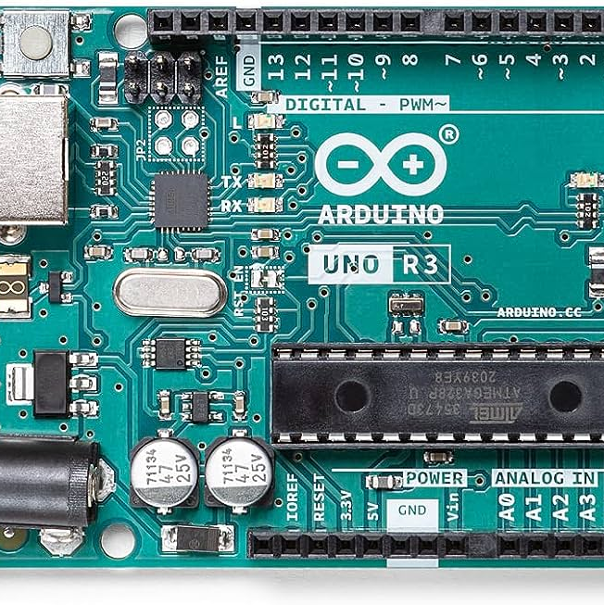
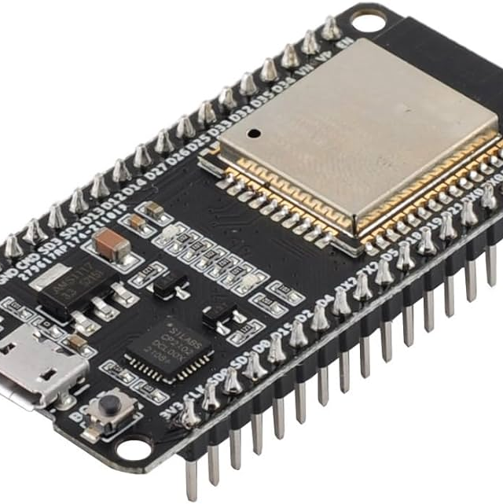
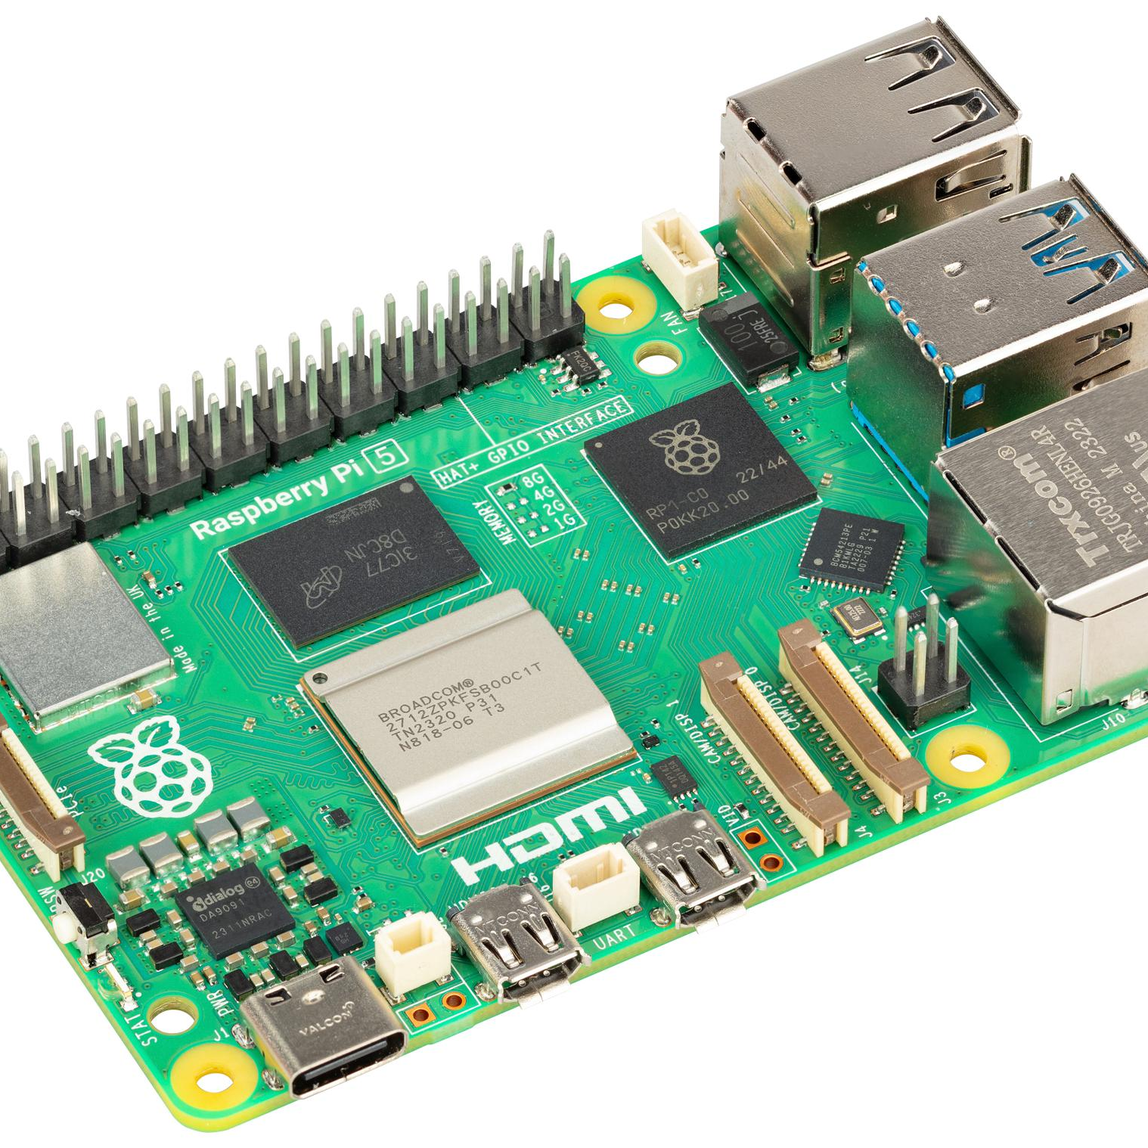
Some Common Microcontrollers:
Arduino (Atmega)
ESP32
STM32
ATTiny
Is it a microcontroller? (≖_≖ )
Raspberry pi
Some Differences Between Microcontrollers (dev) boards.
Cost $$$
Processing Speed
Number of pins
How easy it is to code
The type of voltage they can handle
How much current they require

Slide 5
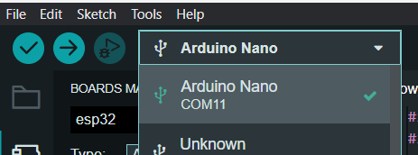

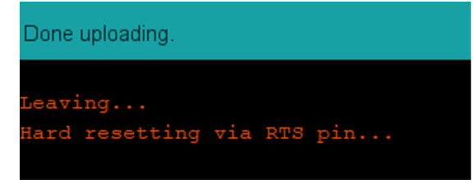
Let’s Get Ready
ESP32
Open up Arduino IDE and go to (File > Preferences > Additional Board Manager URLs) and type in: https://raw.githubusercontent.com/espressif/arduino-esp32/gh-pages/package_esp32_index.json
Go to (Tools > Board > Boards Manager) and type in esp32 and click install on this one:
Go to (Tools > Board > ESP32 Arduino > ESP32 Dev Module)
Plug the board into your computer
Hit the dropdown and find your board. May need to use device manager.
Hold down the boot button on your board and press the right arrow to upload. Let go of the boot button and hit reset when this is seen:
Arduino
Plug the board into your computer
Hit the dropdown and find your board. May need to use device manager.
Click the right arrow to upload the code onto the Arduino
Other Boards
Best of Luck!

Slide 6
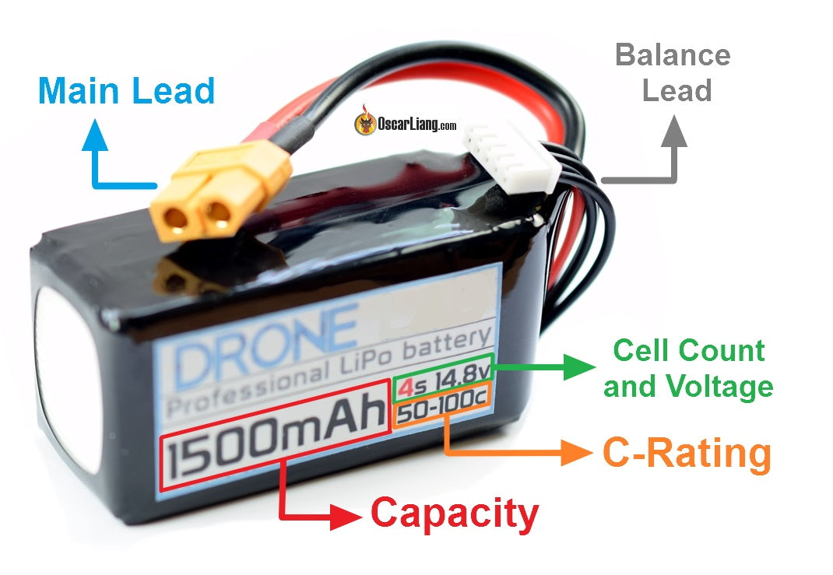
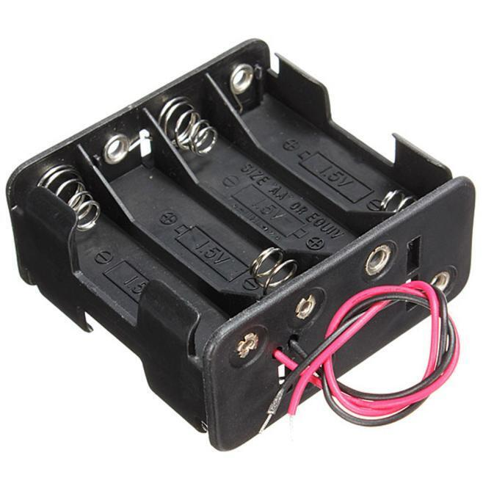
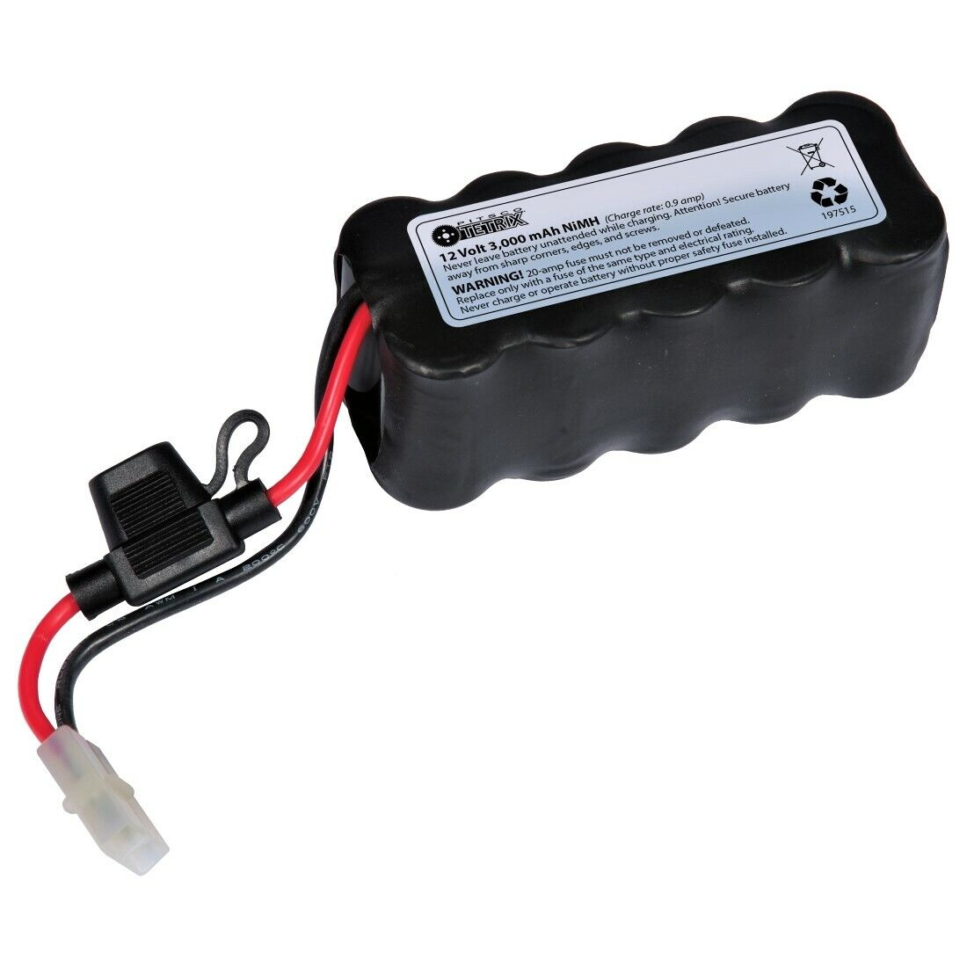
Batteries!!!
Infinite current
Terrifying Expensive-ish ($10-$30) Needs special charging station
Easy to acquire Very cheap Simple charge/replacement Safe
Bulky and heavy Limited to about 2A
Simple charge/replacement Safe Good current supply (10A+)
Bulky and heavy Expensive ($20 - $40) Needs special charging station

Slide 7
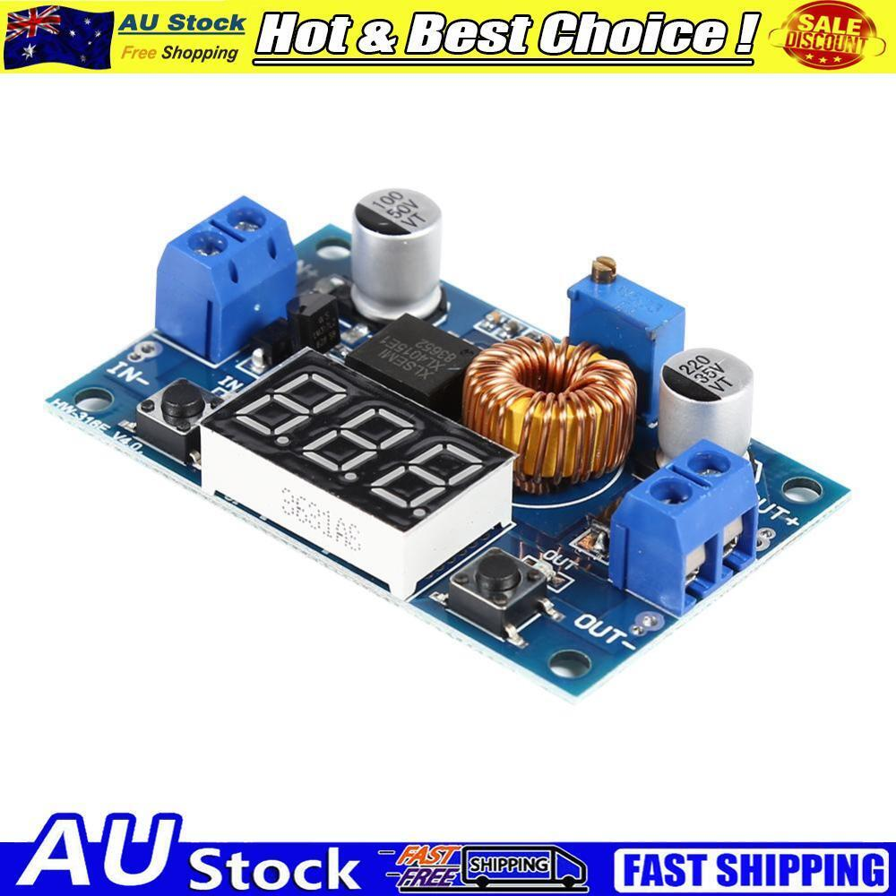
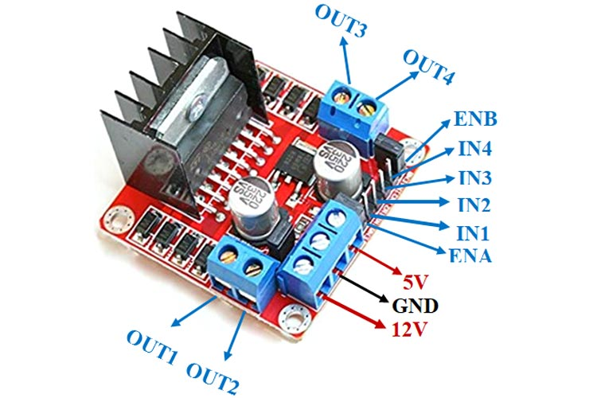
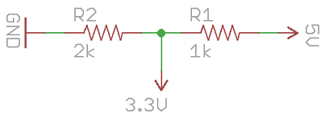
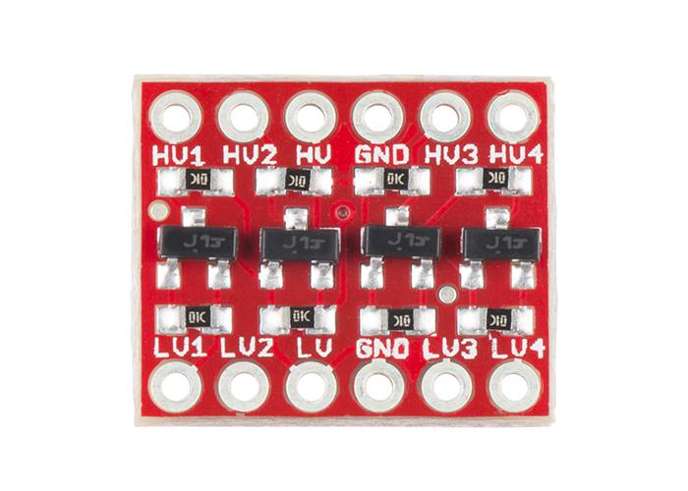
Power Delivery and Control Power (For Arduino and ESP32)
Board Power
Most sensors are 5V or 3.3V
Decent motors are 12V, but they can all take a really wide range
Power Control:
Buck Converter (Switching Regulator)
Linear Regulator (Built into many devices)
 | Arduino | ESP32
Input Power | 7-5V | 3.3-5V
Output Voltages | 5V, 3.3V | 3.3V
Logic Range | 5-3.3V | 3.3V
Max Current Output | 40mA | 40mA
Very efficient Very wide input voltage range Lots of current
Big by comparison Slightly more pricey ($10)
Logic Converting (for ESP32)
Resistor Divider
Level Shifter
Cheap and generally found on other boards
Inefficient Can’t supply much current Has a fairly small input voltage range

Slide 8
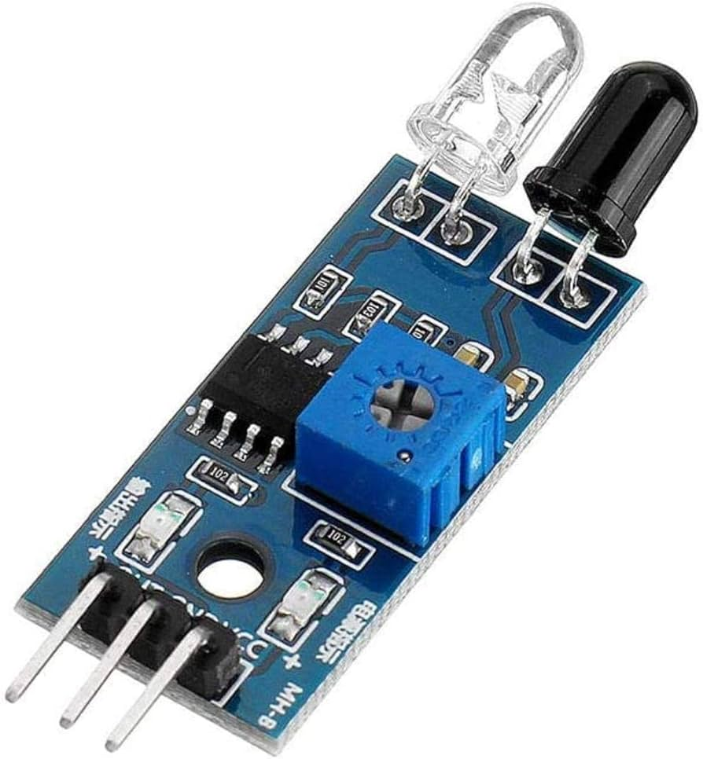
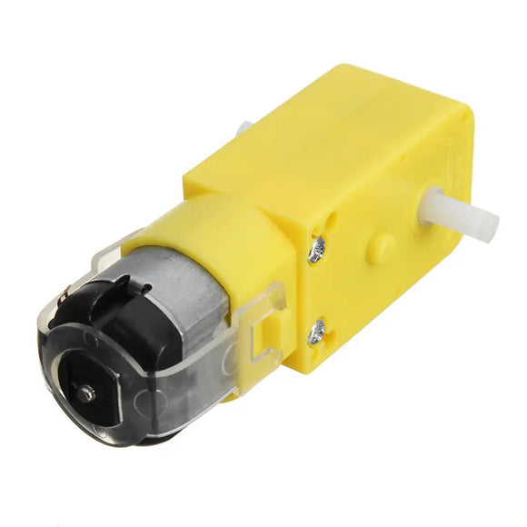
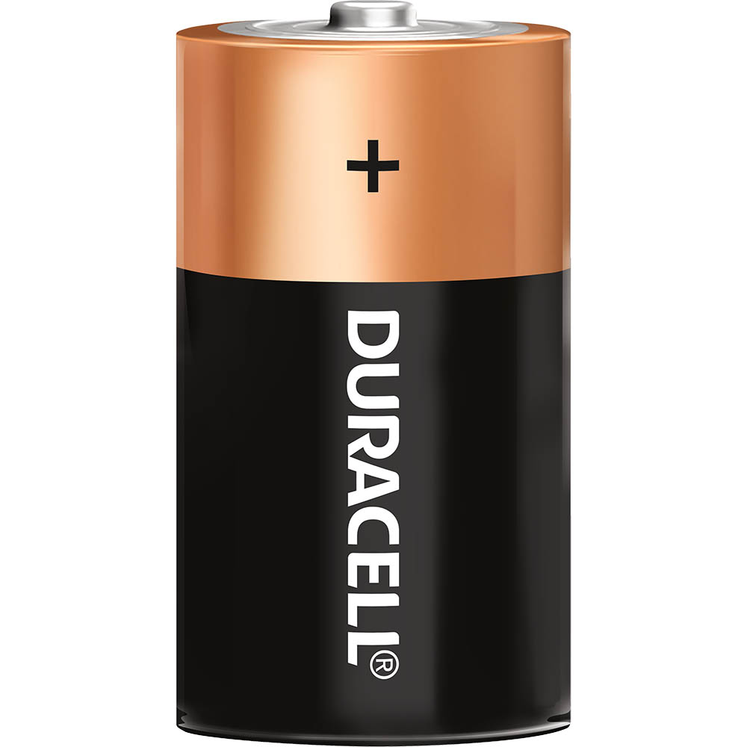
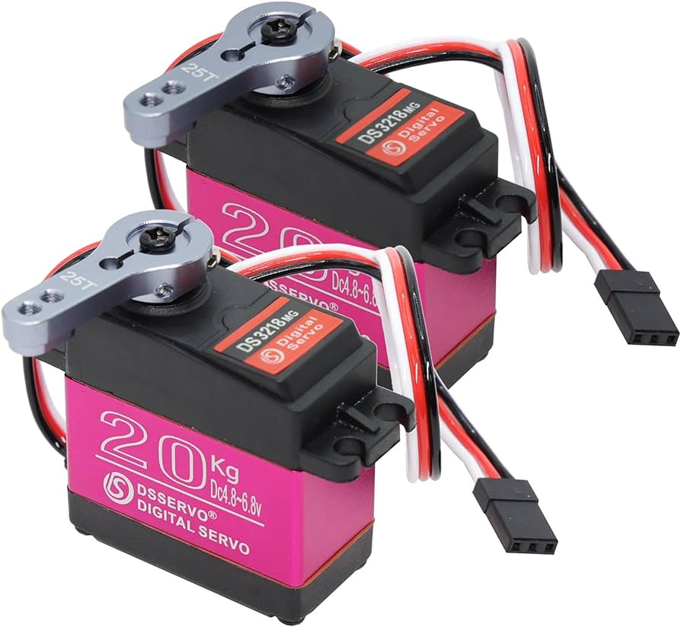
My Hastily Drawn Control System
Signal
Power
Controller
Sensors
5V/3.3V
5V
12V
Motors
Motor
Driver
Power Regulator
5V
Main Power
12V
12V
Servos

Slide 9
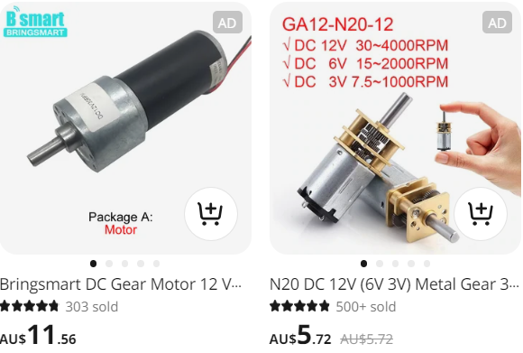
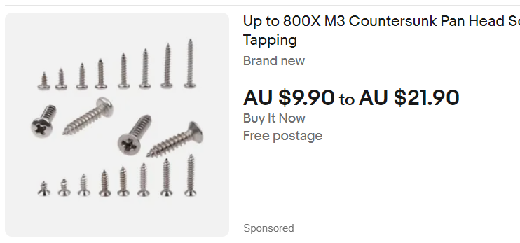
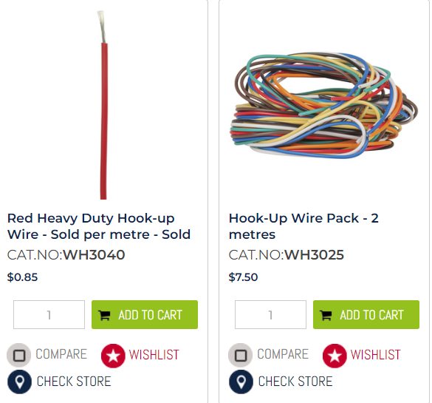
Where to buy stuff
Aliexpress (20 – 40 days)
Only look for ones with many items sold and good star rating
Takes ages to arrive
Very cheap
Don’t buy batteries
Ebay (4-8 days)
Make sure to buy within Australia only
Approximately 1 week delivery
Jaycar (Instant – 2 days)
Has actual stores in Brisbane
Quite expensive and not much stuff
Very handy for instant gear
Other great places include ‘Bolt and Nut’, ‘Core Electronics’, ‘Phaser FPV’,

